Slide 1
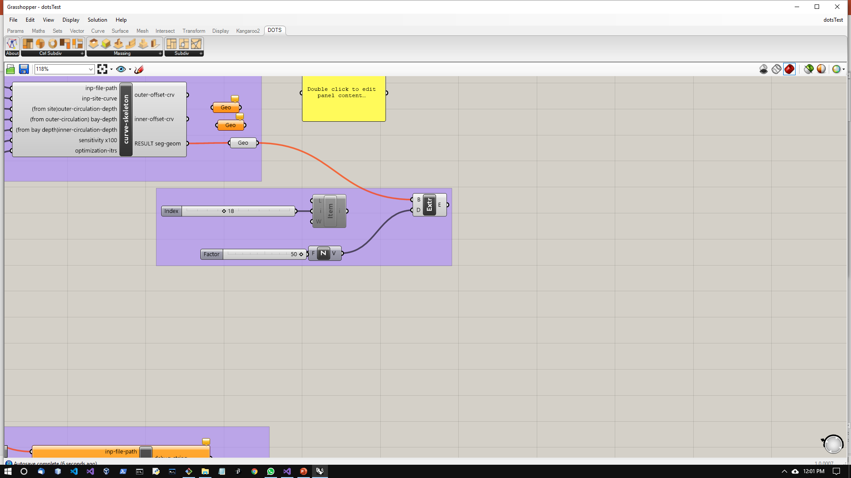
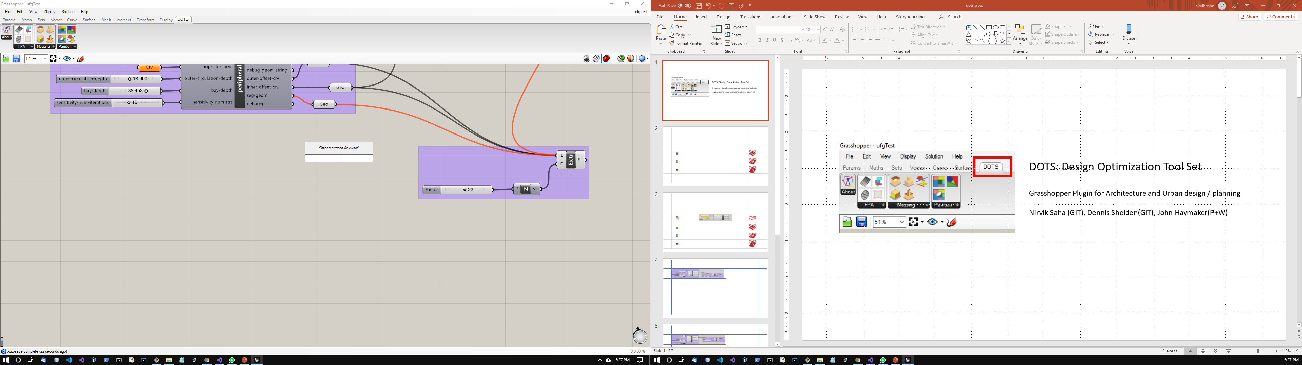
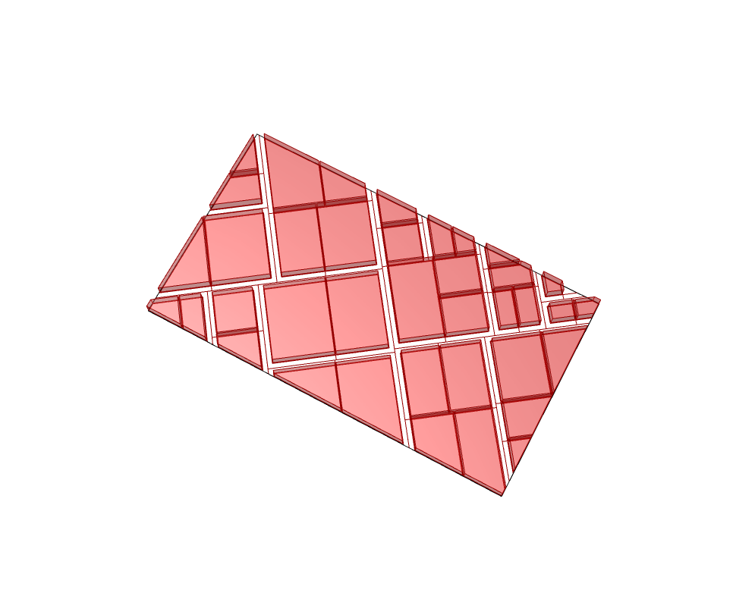
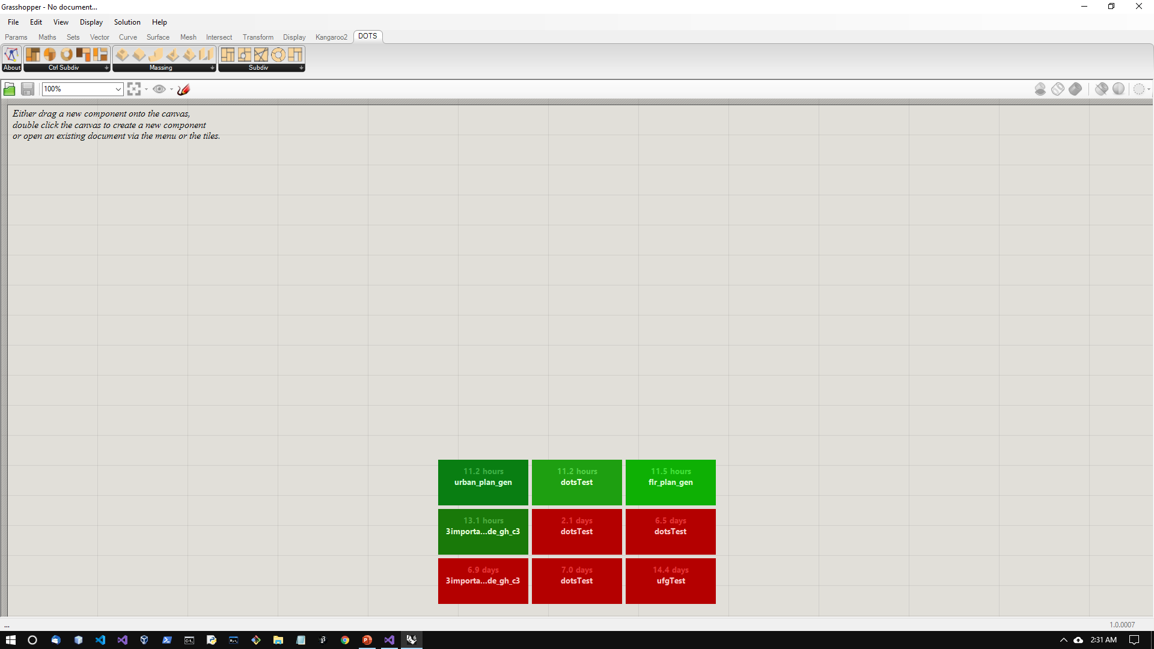
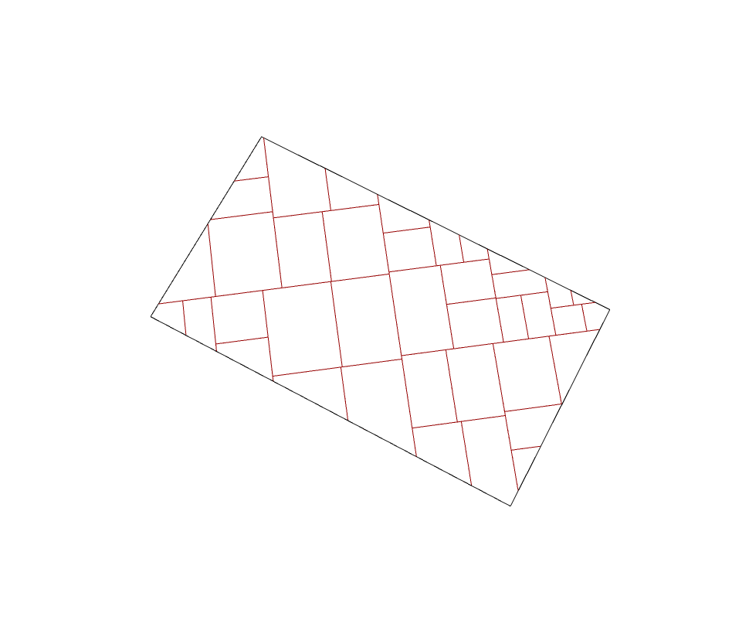
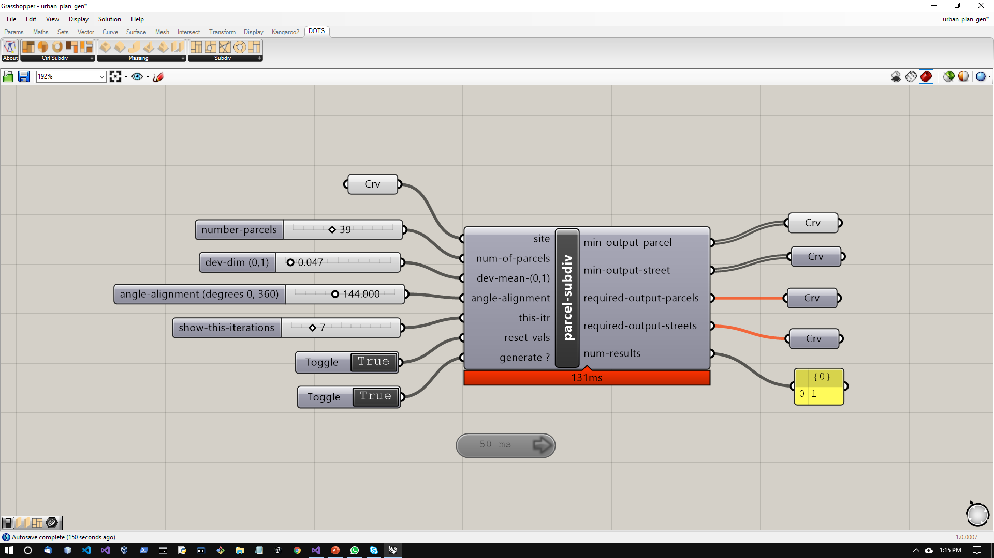
Component Details
Connected to circulation
& Massing
Input site curve
Parcel Curves
Best iteration
Streets
Parcel Curves
Req. Iteration
iteration
Streets
Number of configs in stack
Set Preview to false
Use these to view results

Slide 2
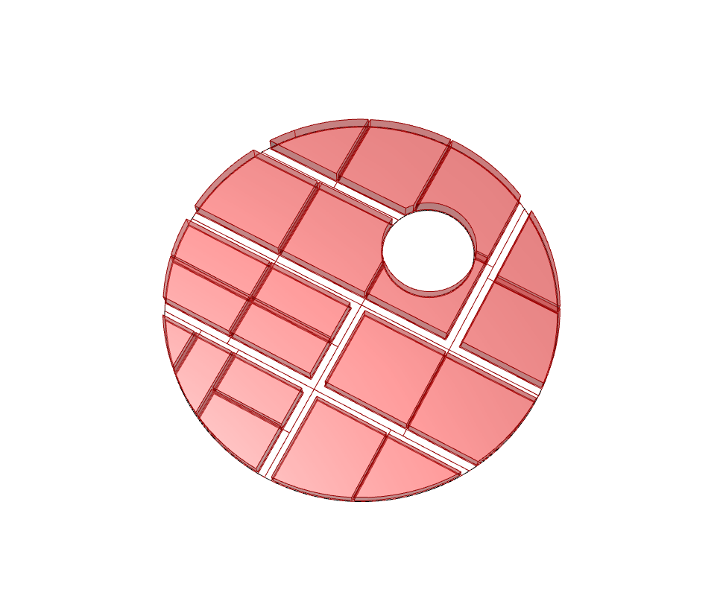
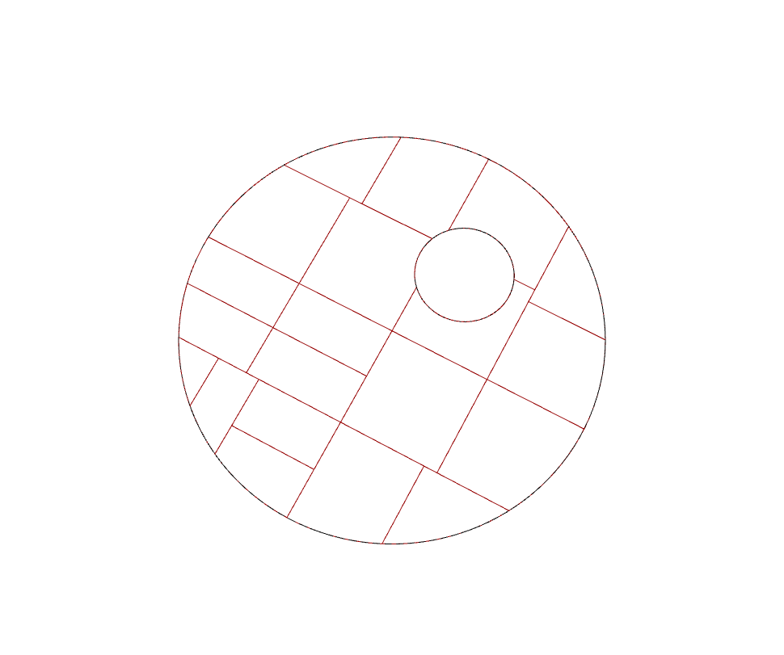
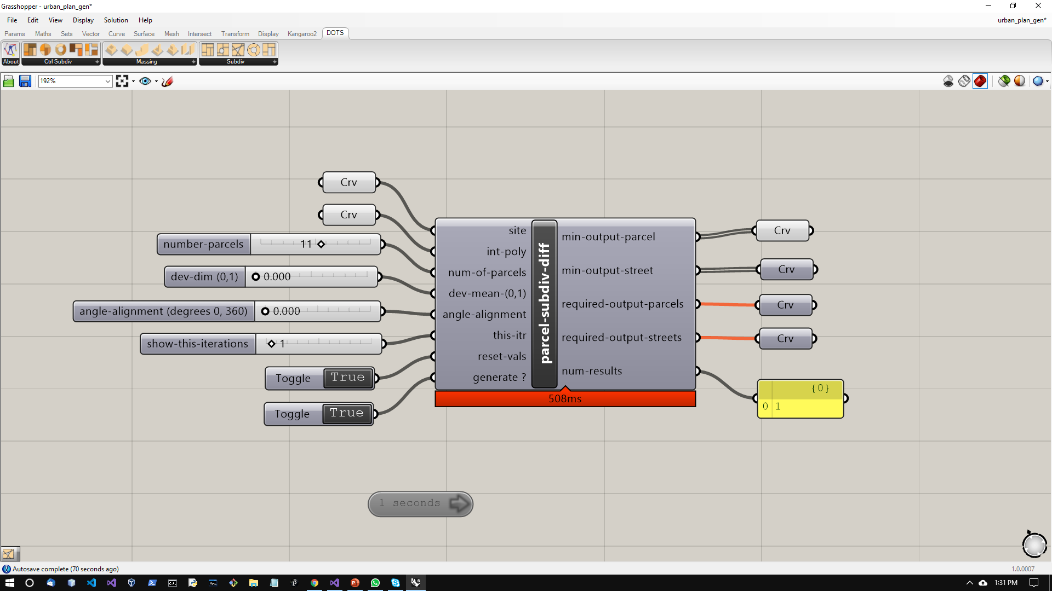
Component Details
Connected to circulation
& Massing
Input site curve
Input subtraction curve
Parcel Curves
Best iteration
Streets
Parcel Curves
Req. Iteration
iteration
Streets
Number of configs in stack
Set Preview to false
Use these to view results

Slide 3
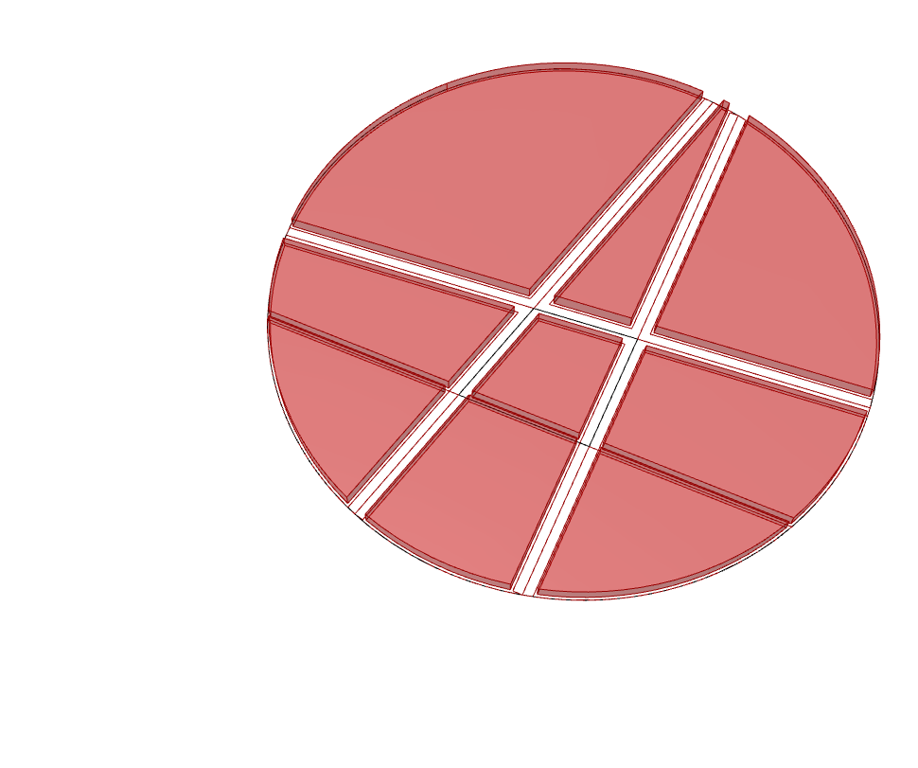
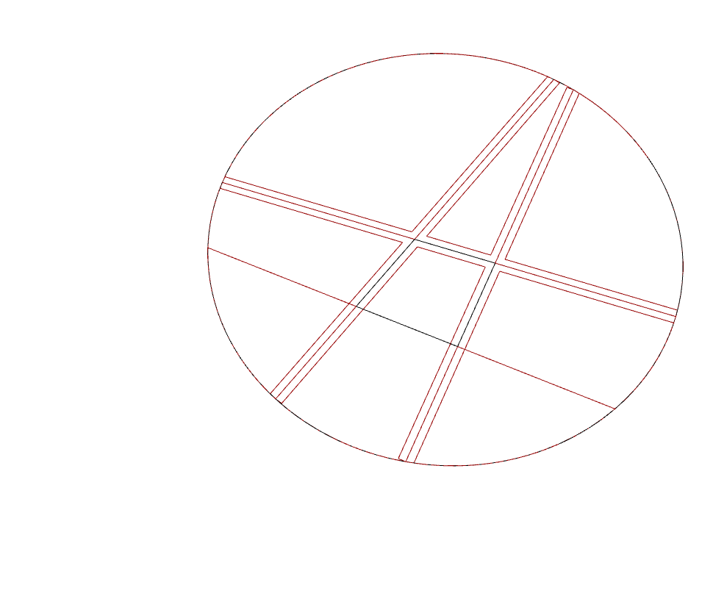
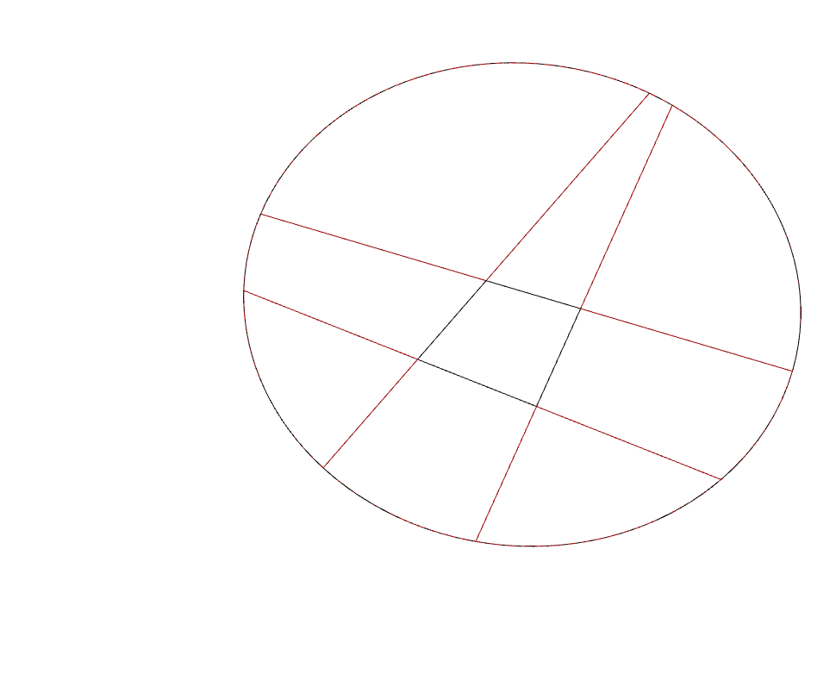
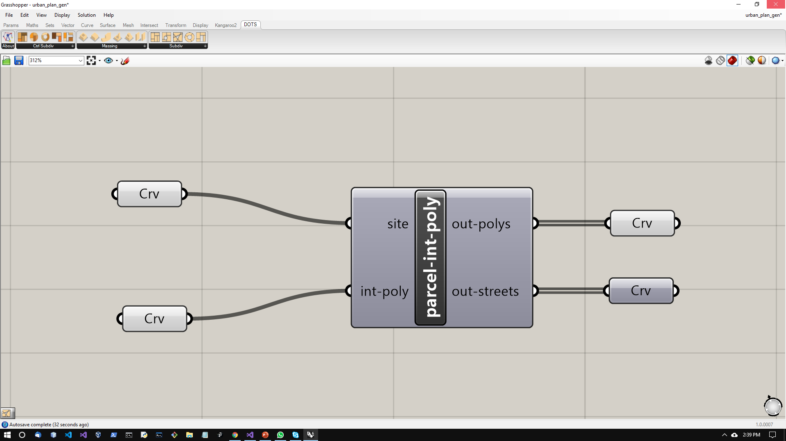
Component Details
Generate Mass
Compute Circulation
Input site curve
Input generator curve
Set Preview to false
Use these to view results

Slide 4
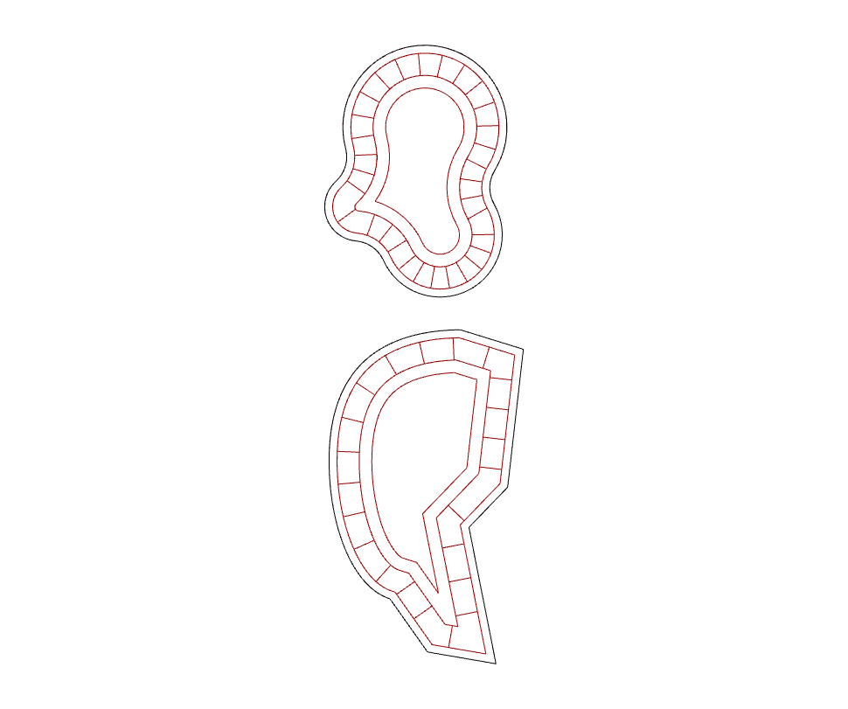

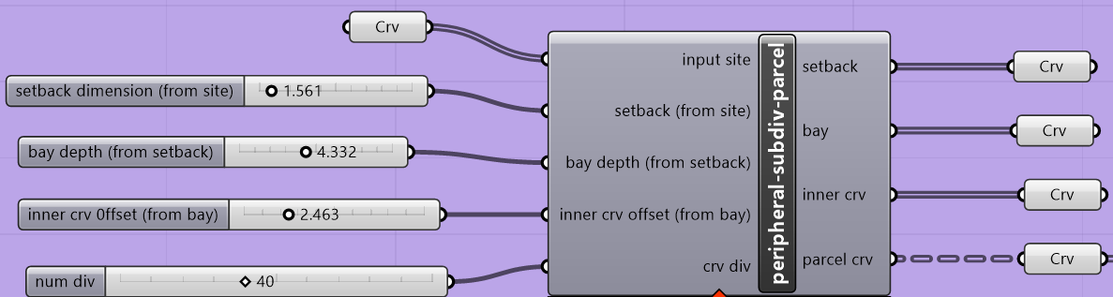
Component Details
Input site curve
Setback
Parcel Crv
Bay
Inner crv
Set Preview to false
Use these to view results

Slide 5
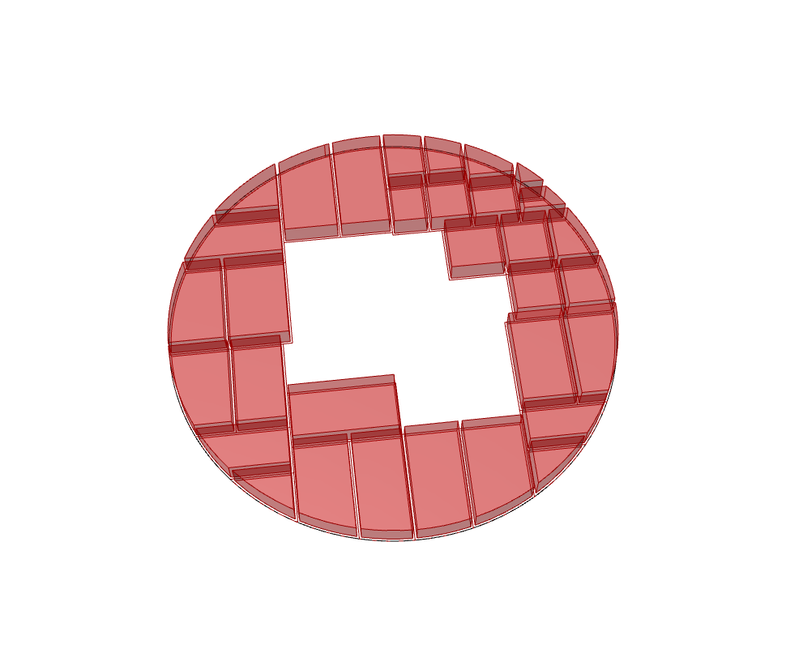
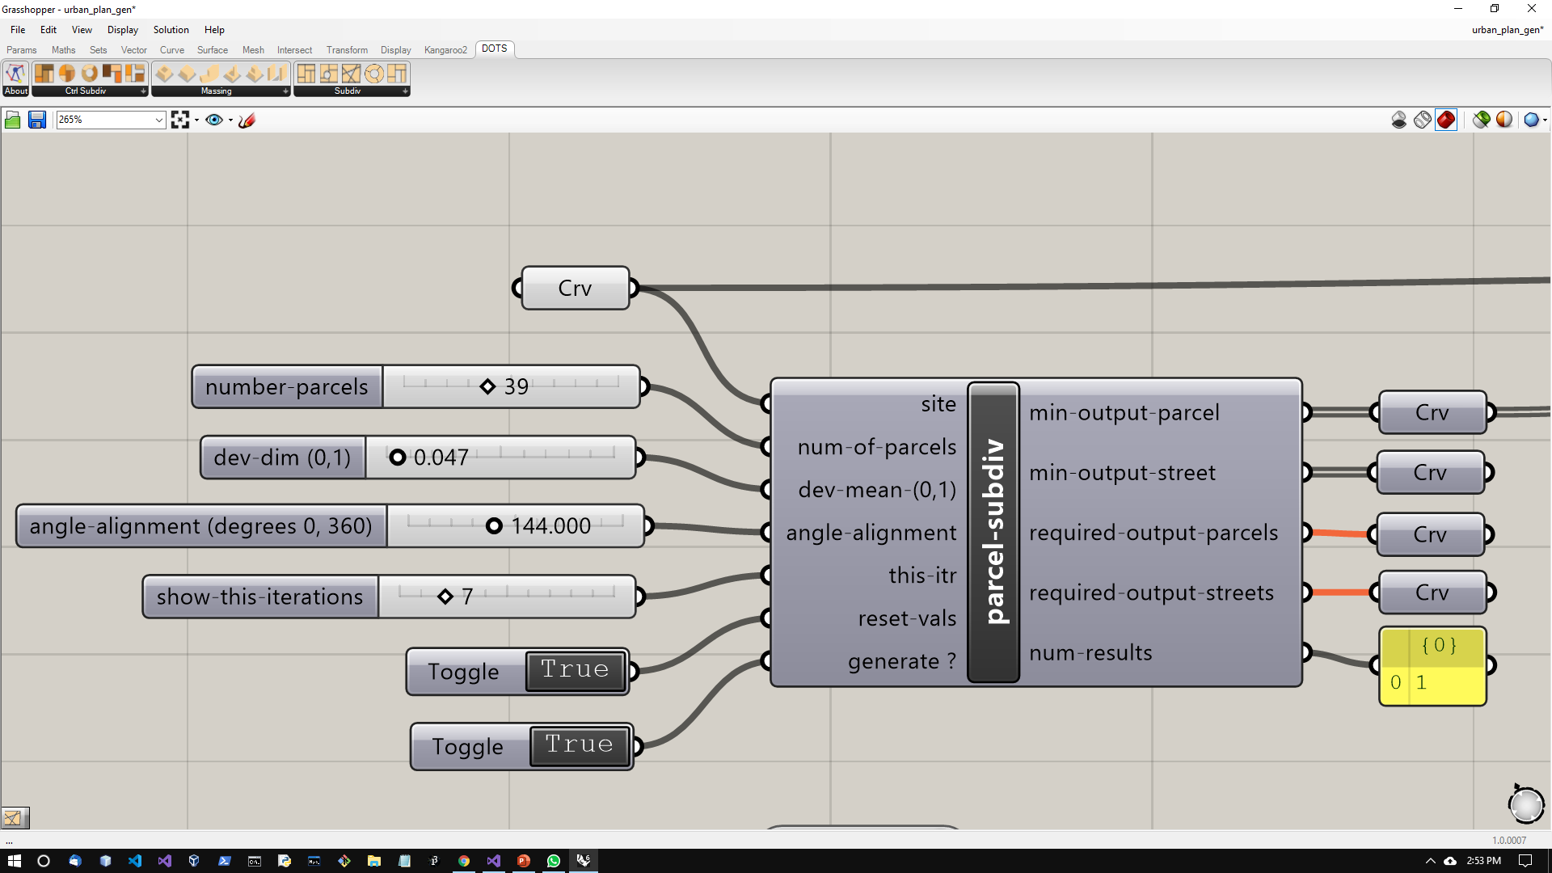
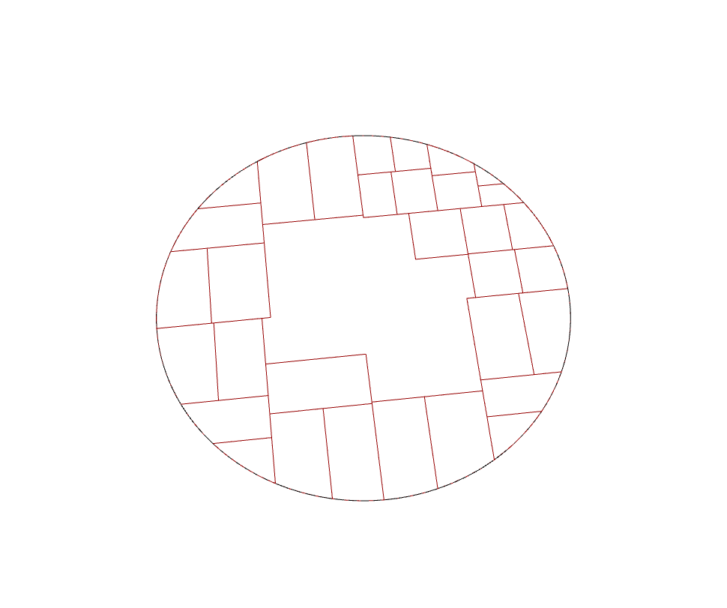
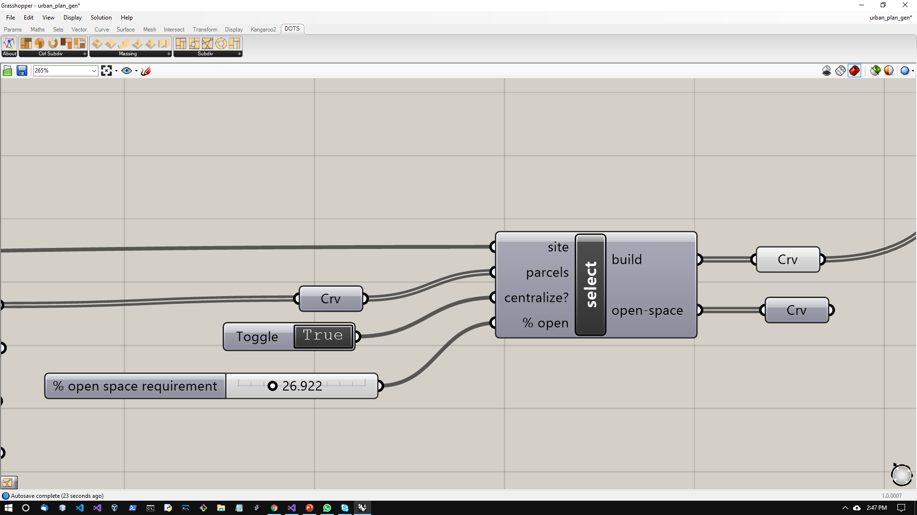
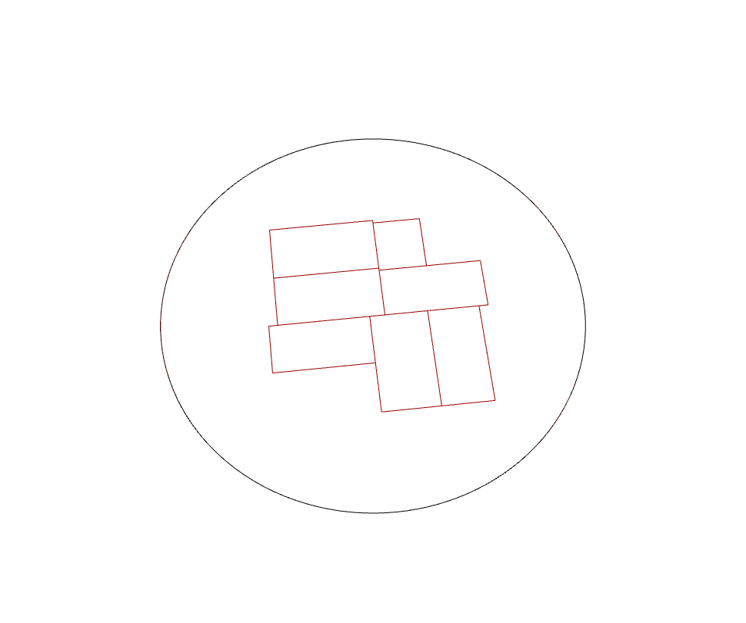
Component Details
Sample of Previous Subdivision Component
Add massing
From Subdivision component
Set Preview to false
Use these to view results

Slide 6
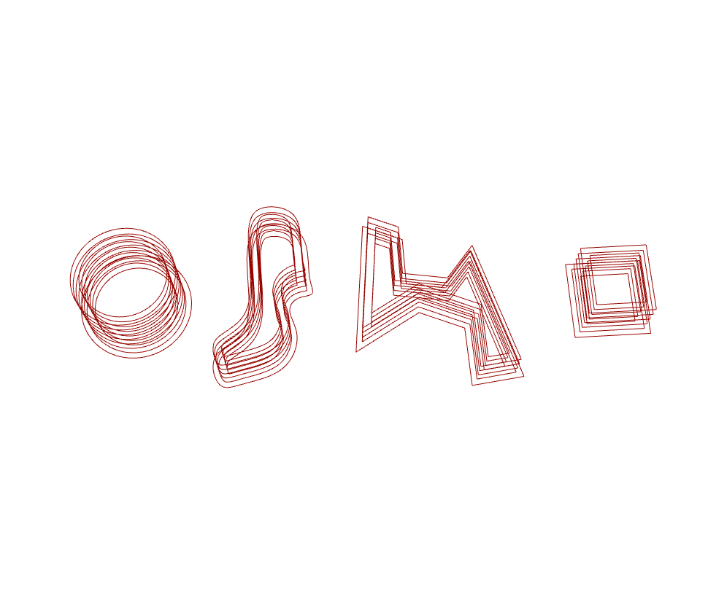

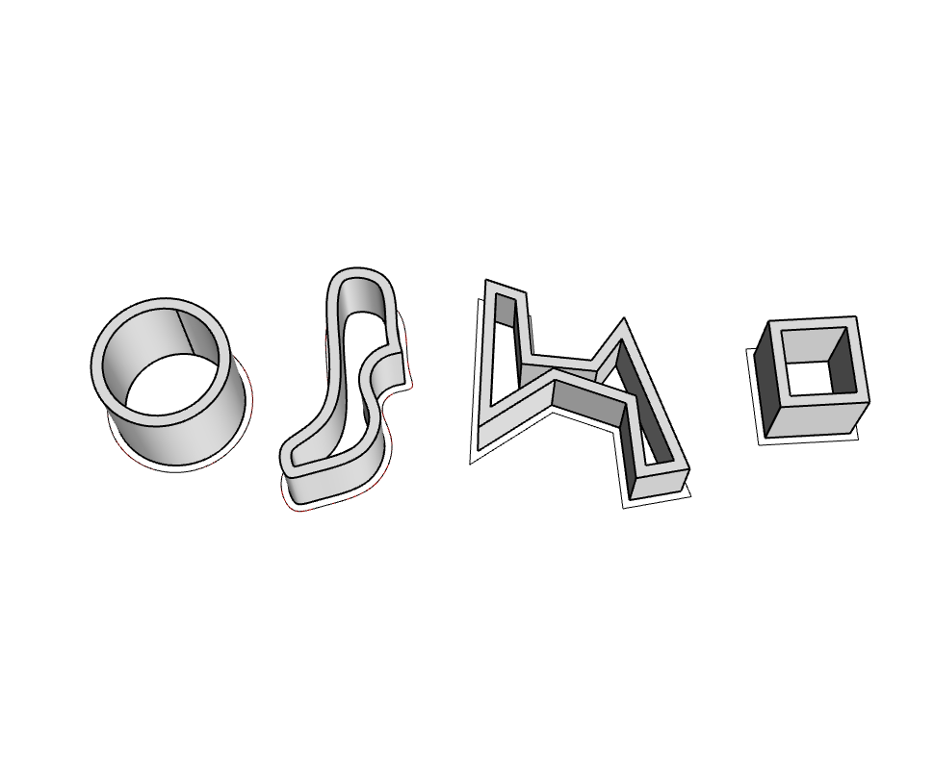
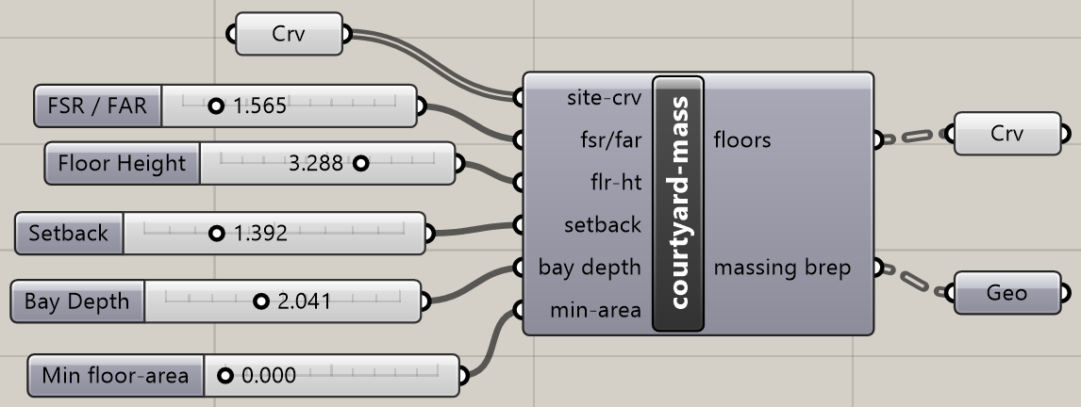
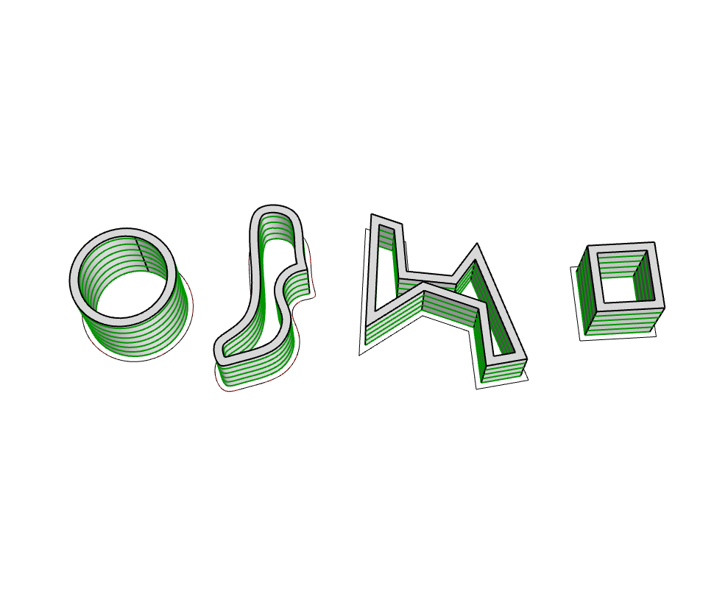
Component Details
Floor Curves
Massing Brep
Floor Curves
Massing Brep
Set Preview to false
Use these to view results

Slide 7
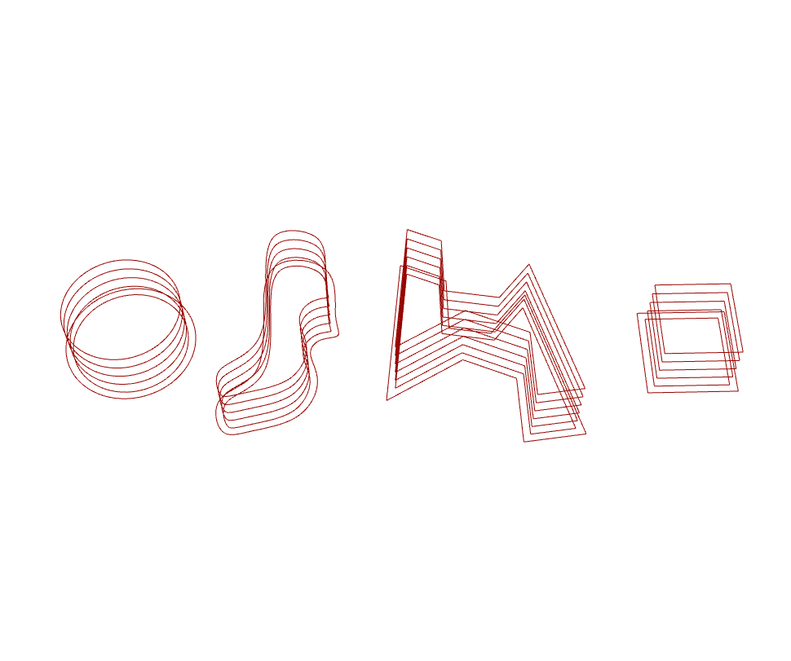
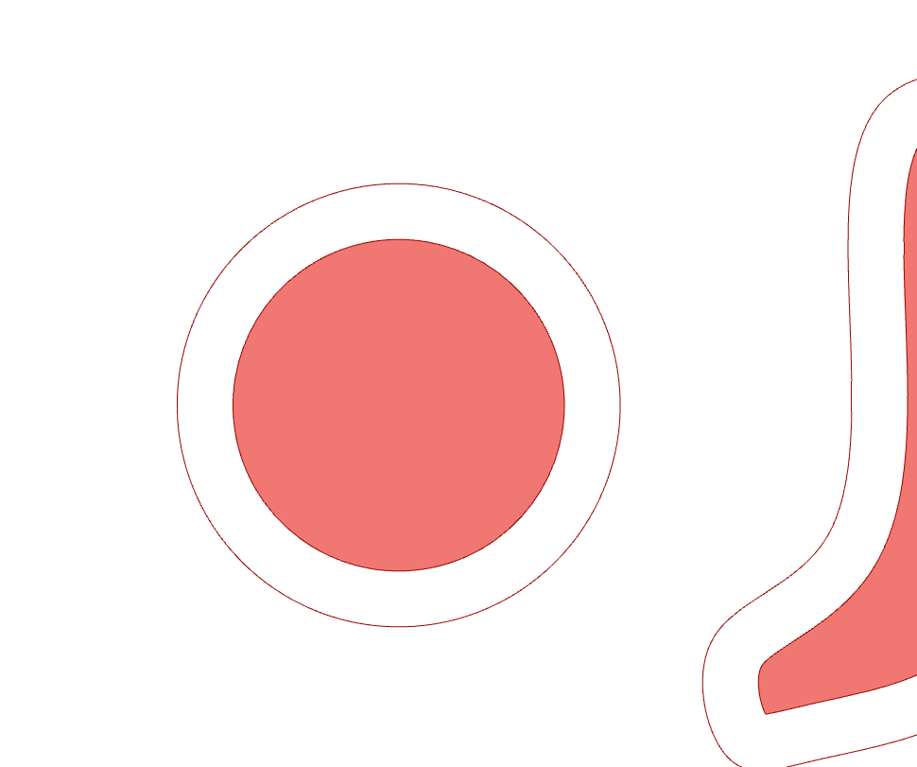
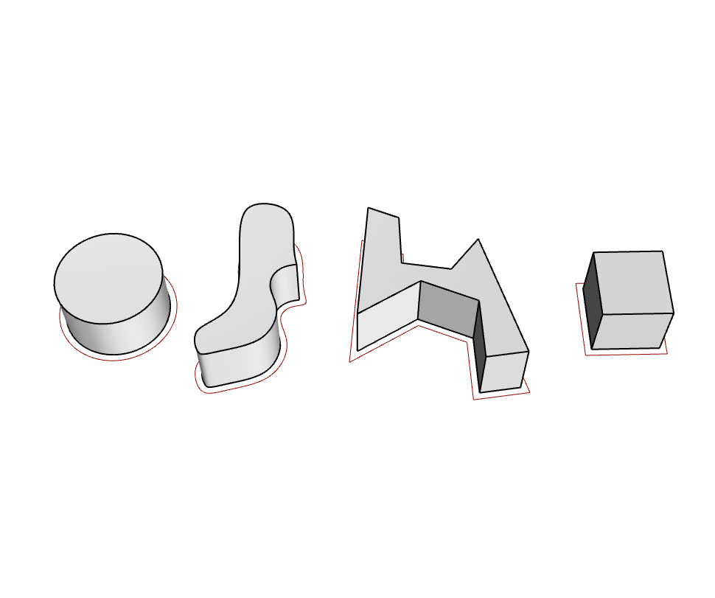
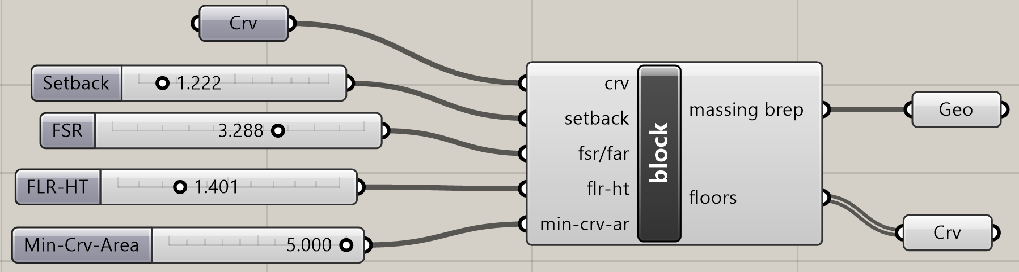
Component Details
Floor Curves
Massing Brep
Massing Brep
Floor Curves
Set Preview to false
Use these to view results

Slide 8
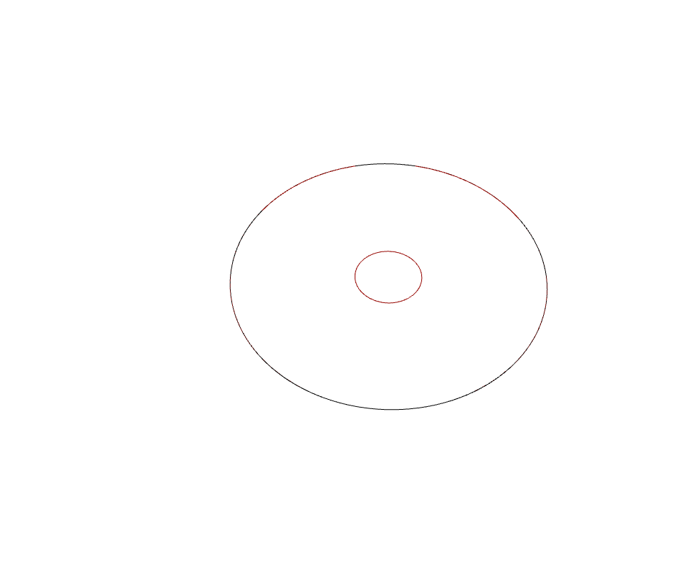
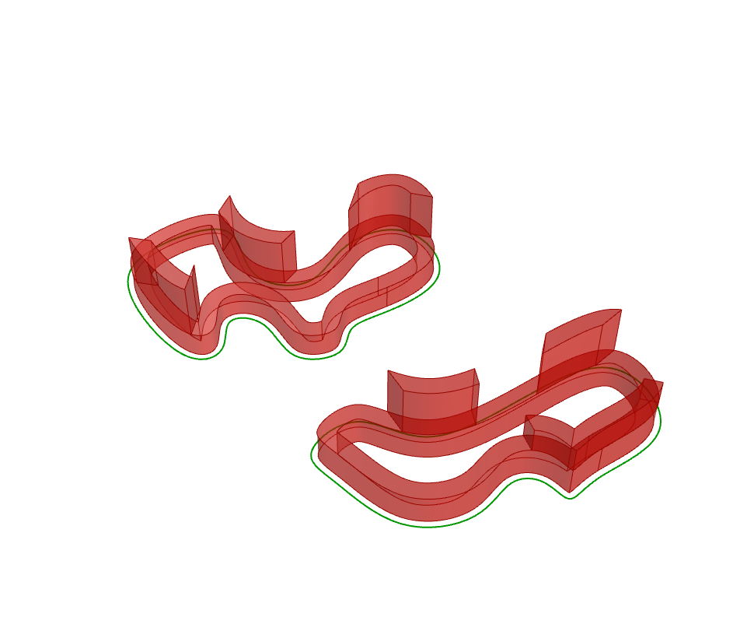
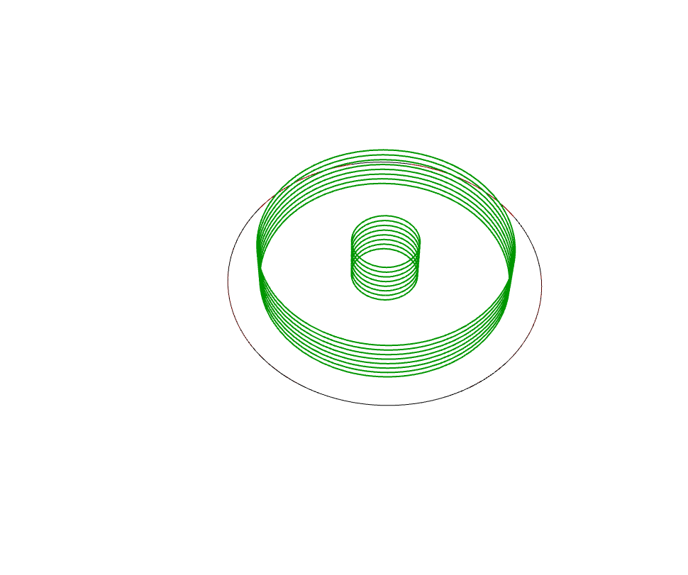
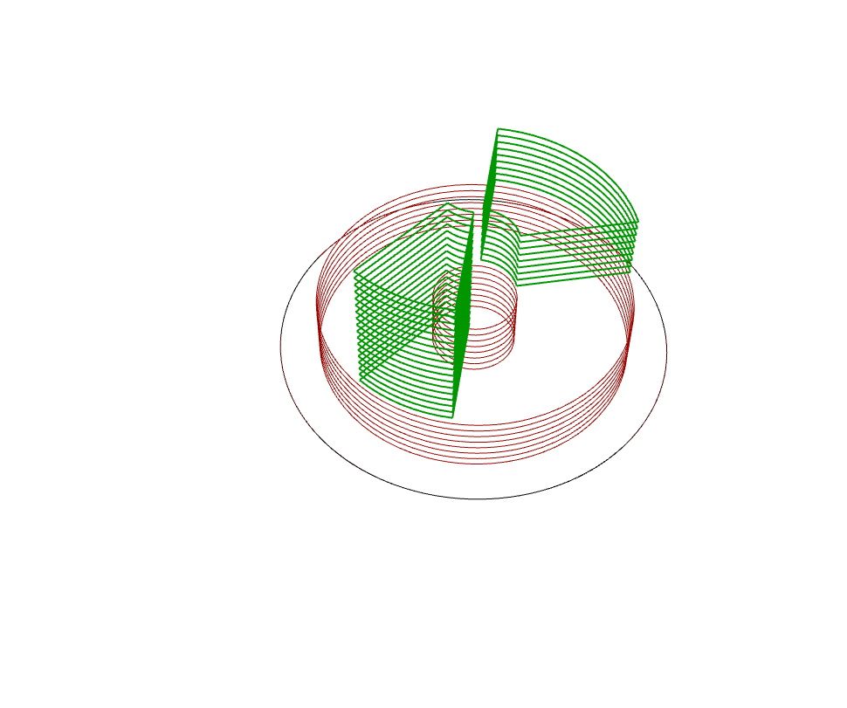
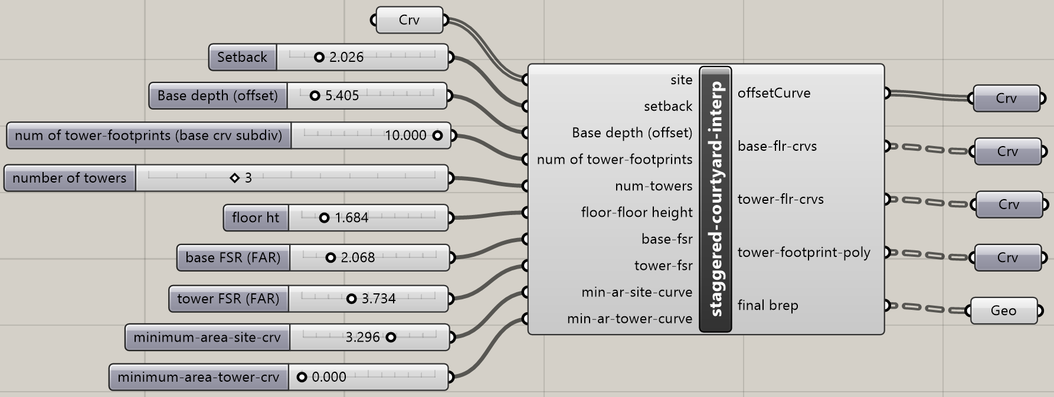
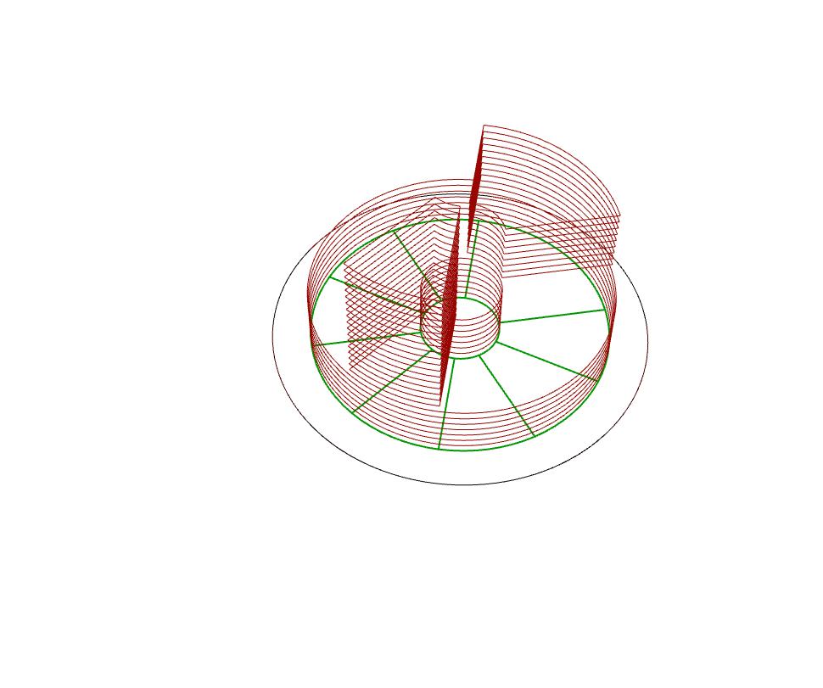
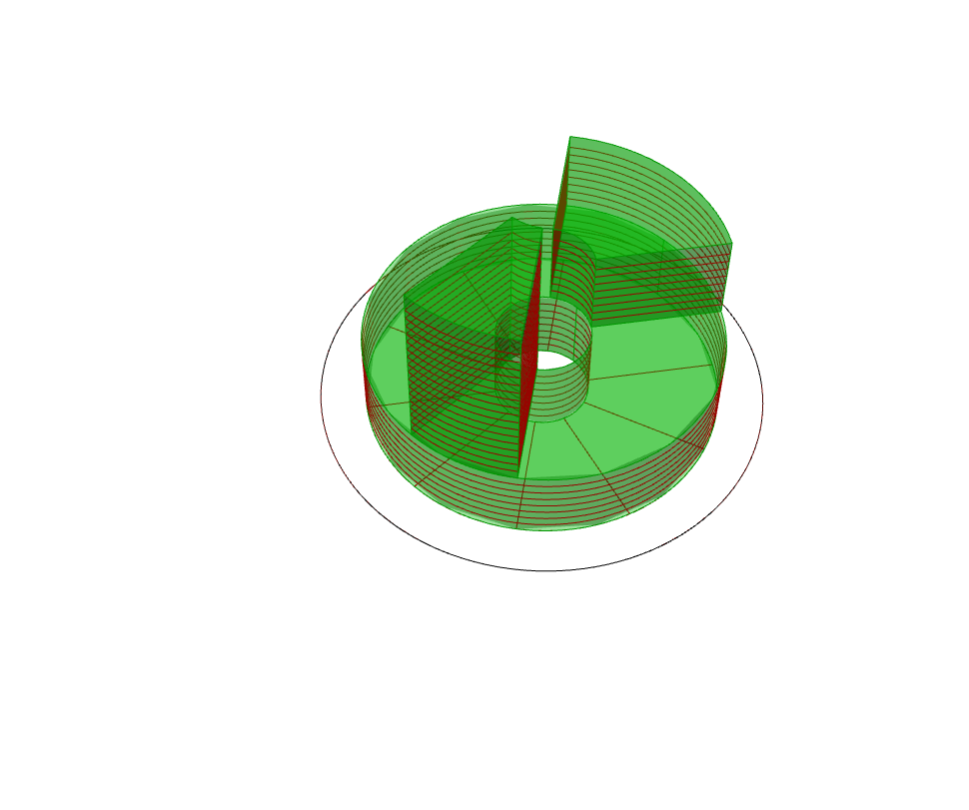
Component Details
Set Preview to false
Use these to view results

Slide 9
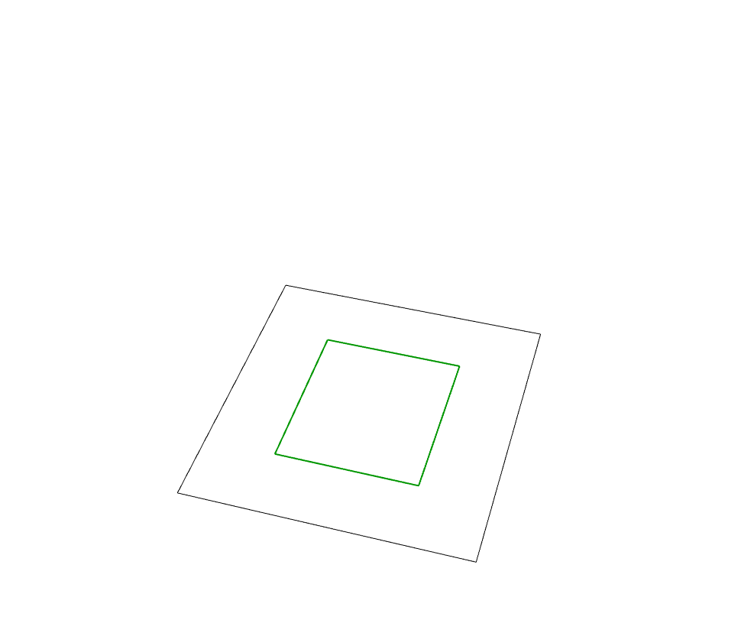
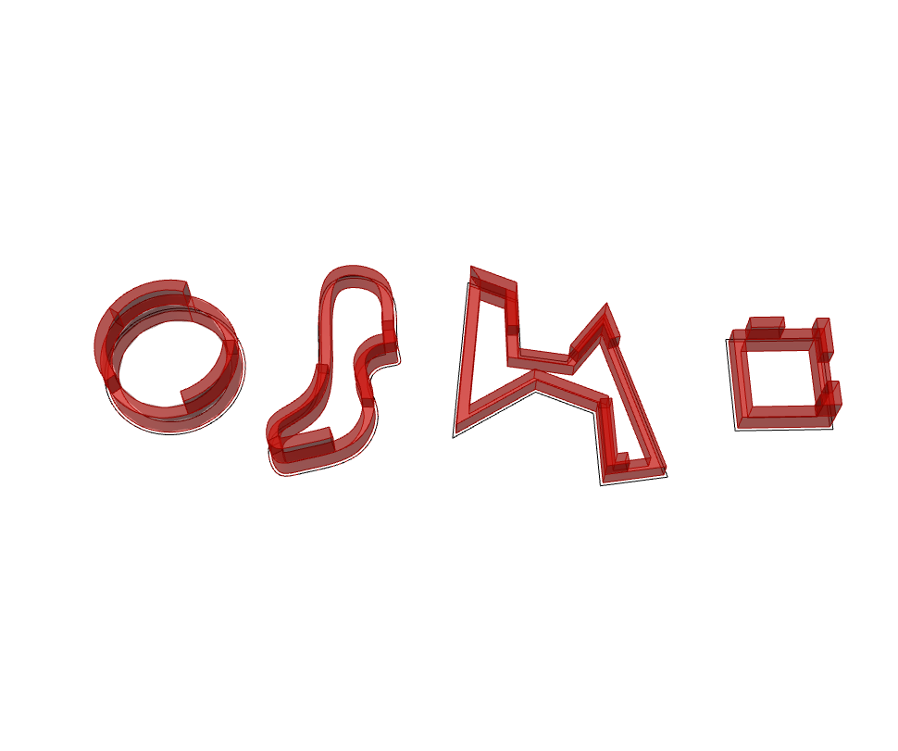
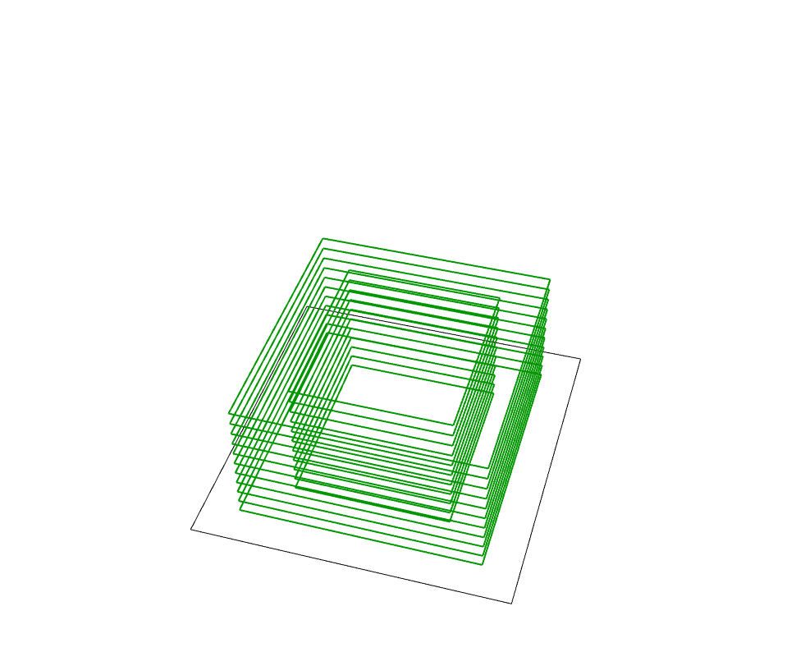
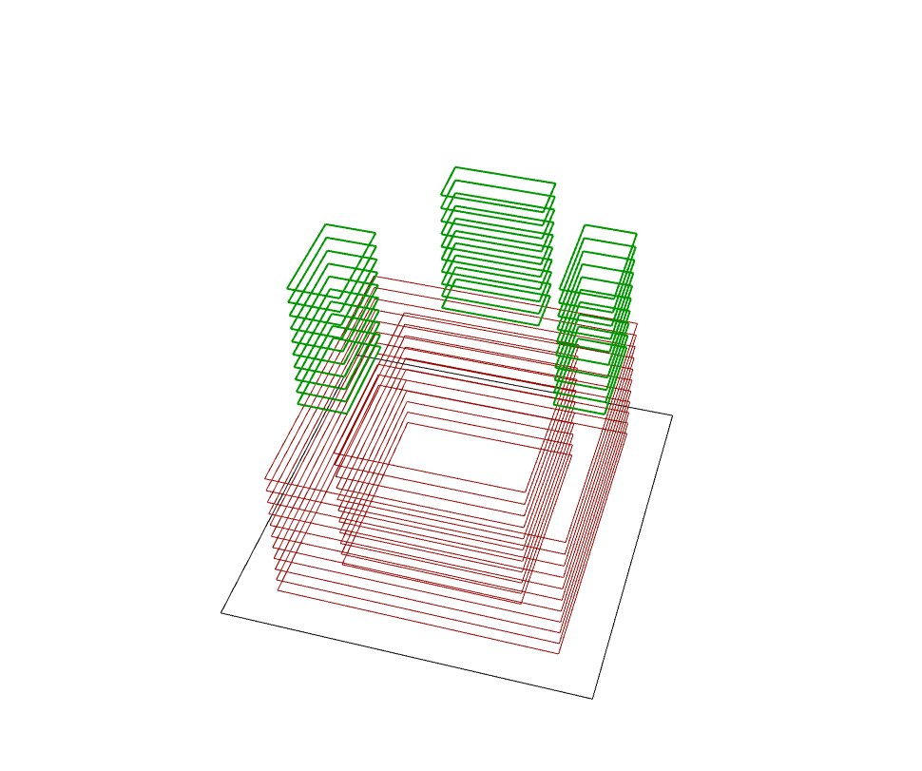
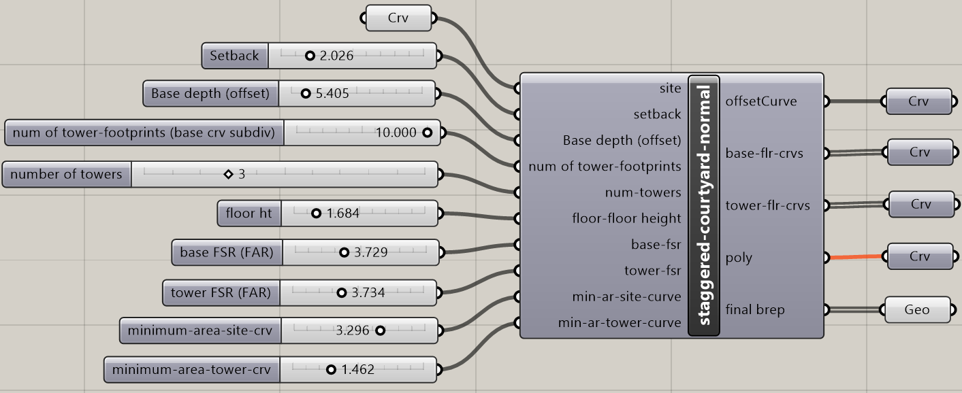
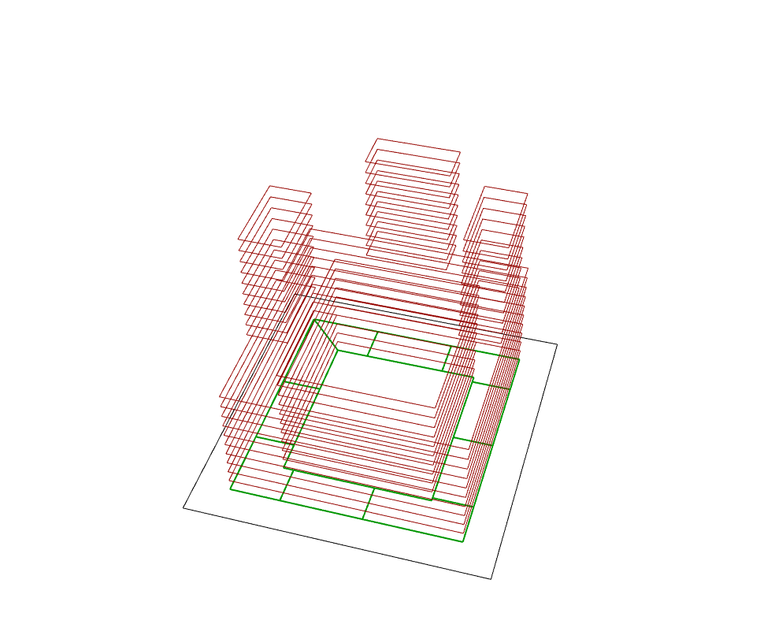
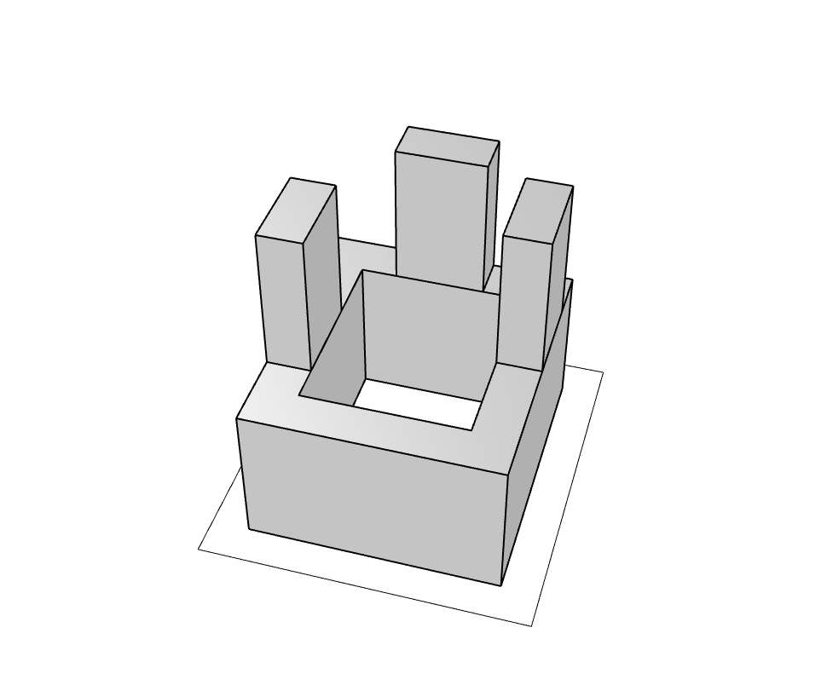
Component Details
Set Preview to false
Use these to view results

Slide 10
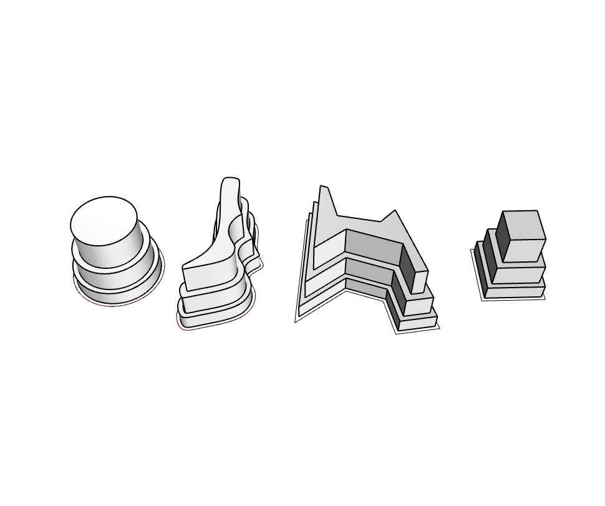
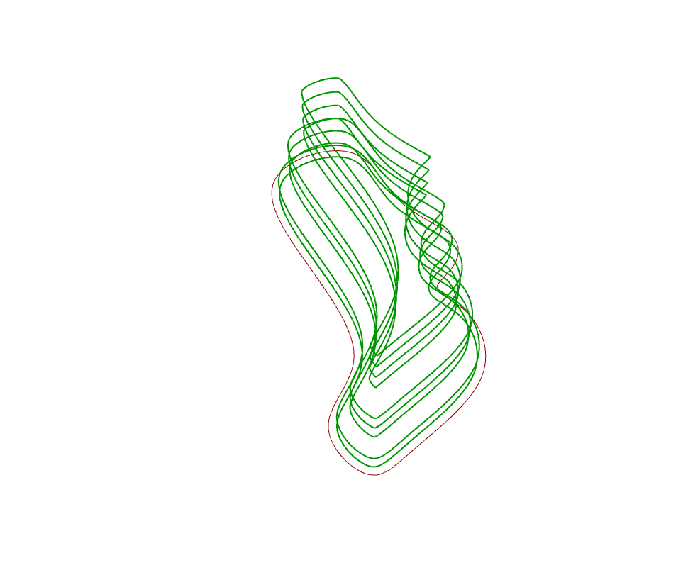
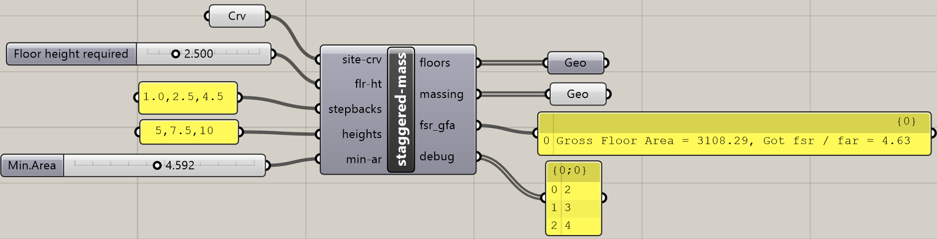
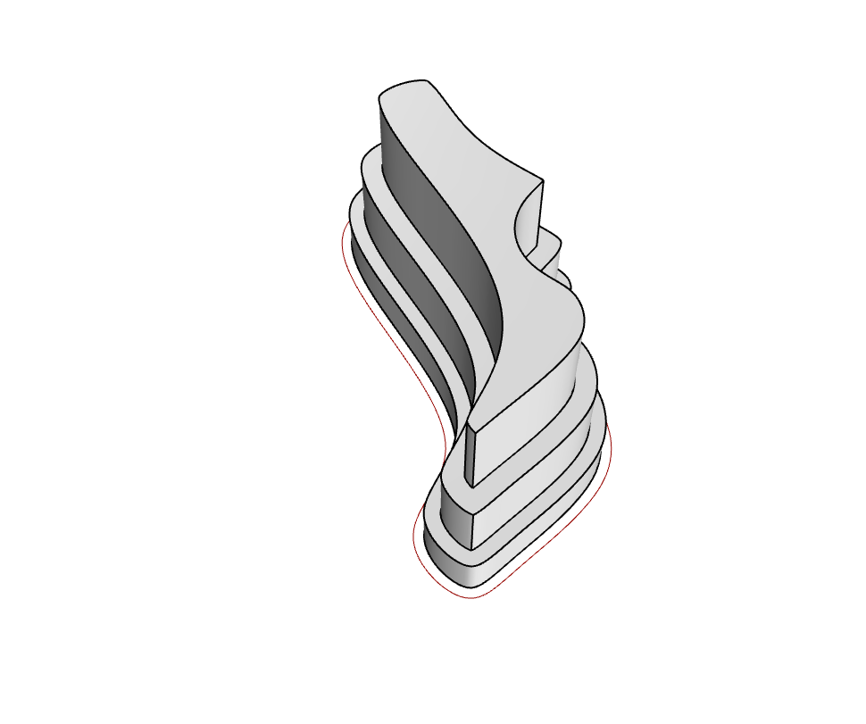
Component Details
Notes:
Using this component, a number of small parcels along a street network can be extruded based on setback for each street. The street name separated by comma and setback distance separated by comma are input. It references a Rhino3d layer for the street centerline geometry and checks which site is closest to what street. Then the corresponding setback value is used to determine the region which can be extruded. Finally based on the FSR, the region is extruded and massing generated.

Slide 11
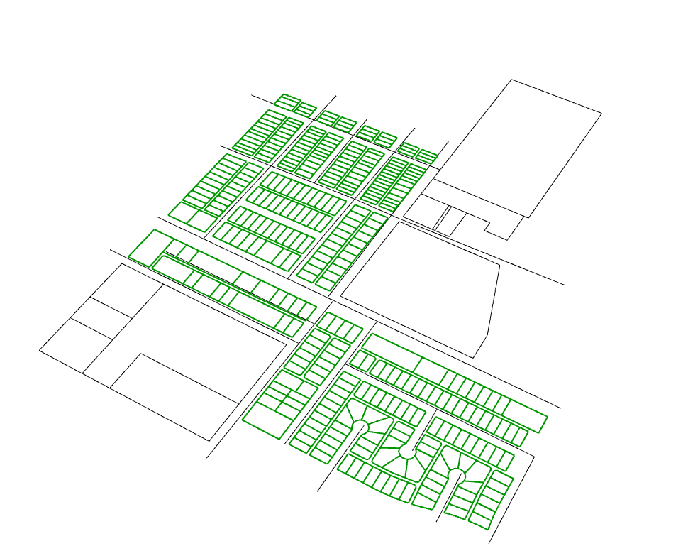
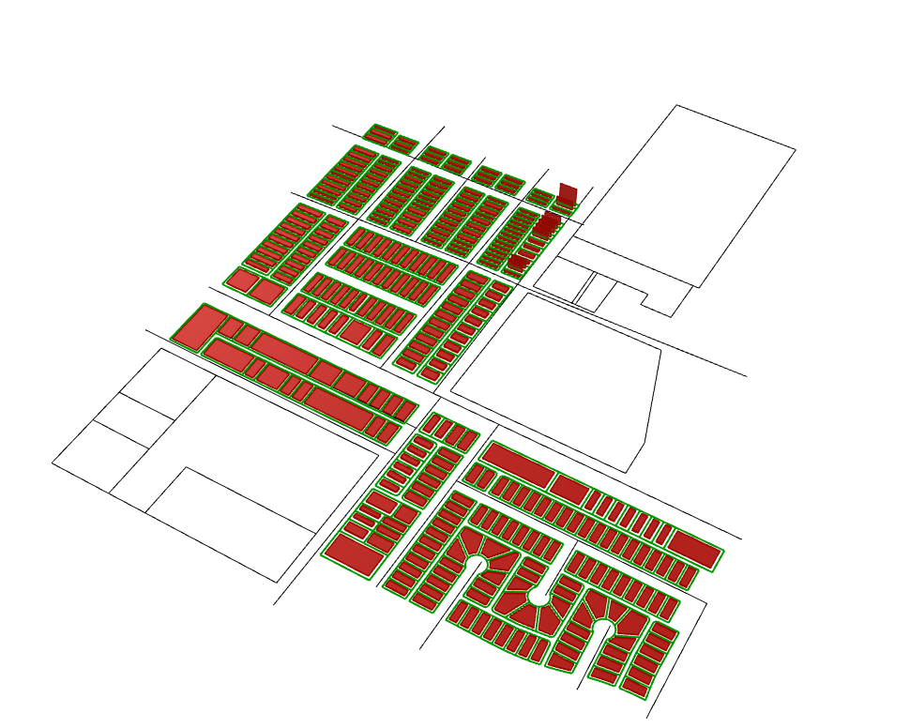
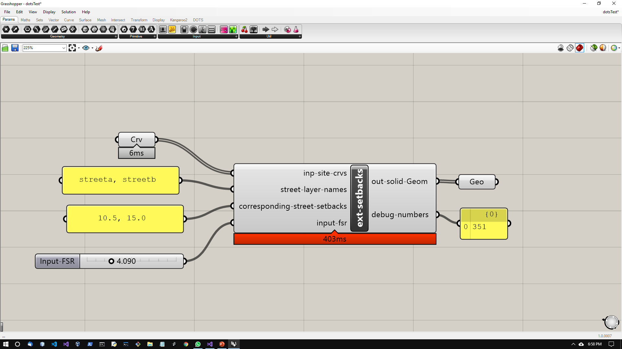
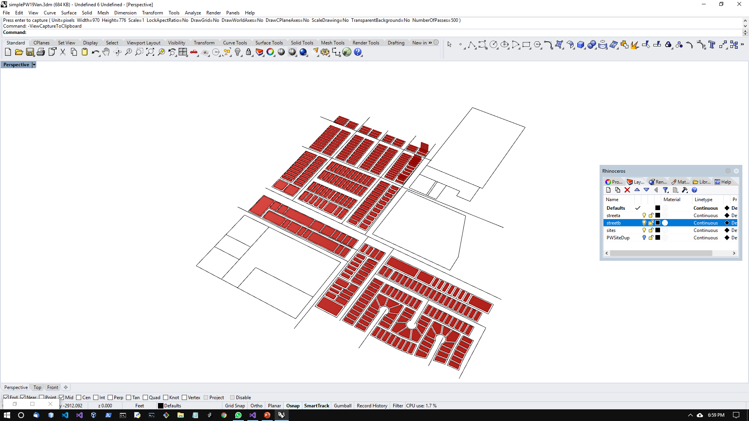
Component Details
streets
sites
streets
Corresponding setback depths
Set the FSR / FAR
Notes:
Using this component, a number of small parcels along a street network can be extruded based on setback for each street. The street name separated by comma and setback distance separated by comma are input. It references a Rhino3d layer for the street centerline geometry and checks which site is closest to what street. Then the corresponding setback value is used to determine the region which can be extruded. Finally based on the FSR, the region is extruded and massing generated.

Slide 12





Component Details
Connected to Circulation
Right-Click:
“Set File Path”:
navigate to file
Name of space
Outer rectangle
Randomize geometric ops
Optimization iterations = max 500
Set Preview to false
Use these to view results

Slide 13



Component Details
Connected to Circulation
Right-Click:
“Set File Path”:
navigate to file
Name of space
Randomize geometric ops
Optimization iterations = max 500
Set Preview to false
Use these to view results

Slide 14


Component Details
Site curve
outer-circulation depth
Bay depth
inner-circulation depth
Right-Click:
“Set File Path”:
navigate to file
Name of space
Sensitivity = x, where 0.1<x<5.0
Optimization iterations = max 500
Set Preview to false
Use these to view results

Slide 15



Component Details
Name of space
Right-Click:
“Set File Path”:
navigate to file
Sensitivity = x, where 1<x<10

Slide 16



Component Details
Preview off output 0, 1
Ex. Previous Generative Component
Set Preview to false
Use these to view results

Slide 17


Component Details

